Slide 1
Maple Hills Volunteer Training
2022-2023

Slide 2
Thank you! We are excited to have you back in the building!
Your willingness to volunteer helps…
Provide students with additional activities.
Teachers complete tasks they don’t have enough time for.
Create a school-community team environment.
Give students another adult to read/work with.
Teachers to work with even more students every day.
Students to see parents who are engaged and involved in education.

Slide 3
Upon arrival…
Arrive at the day and time you and the teacher have agreed upon.
Check in at the office.
Sign in to the Volunteer Log
Get a visitor/volunteer badge. Wear/display the badge at all times when in the building.
Turn off or silence cell phones. We do not allow cell phone conversations within the building during the school day.
Check in with the teacher about what tasks they have planned for you.

Slide 4
Classroom Volunteers
Every teacher utilizes volunteers in a different way. Some teachers have volunteers scheduled for specific activities, like art projects, reading groups, etc. Some teachers use volunteers for more clerical tasks to keep their classroom running smoothly. Some teachers have volunteers work one-on-one with students in the classroom or the activity hall. It depends on the teacher’s preferences.
As students get older, intermediate teachers are working on building independence so volunteers in 3rd, 4th and 5th grade do not always support students directly.

Slide 5
Volunteer Agreement – I agree to…
Wear my name tag/badge at all times.
Leave my parent hat at home. I am here to help the teacher and all students, not just my own.
Remember and honor that teachers have different teaching styles.
Assist students by giving them help not interfering with their learning.
Respect each student’s ability, learning style, and right to privacy.
Notify the teacher in case of a student injury.
Ask for an appointment if I need one-on-one time with the teacher, regarding my own student.
Let the teacher know if there is a problem and not discipline or consequence students myself.

Slide 6
Confidentiality
From District Regulation 5630 and The Family Educational Rights and Privacy Act, 34 CFD Part 99.
Volunteers may not discuss the performance, actions, or any other information about any student except with the student’s teacher, school counselor or principal. Confidentiality pertains to both written records and verbal statements.
Privacy includes behavior and academic performance.
Never discuss with the teacher within earshot of another parent or student.
Teachers may need to share information with you, but that information may not leave the classroom.

Slide 7
Volunteer Etiquette
To best know how to interact with and support students, watch the teacher and model his/her strategies.
Please do not chat with adult friends during class time or in the main office as it is distracting to the students & teacher.
Please respect the confidentiality of the staff lounge and health room by not going in the lounge during lunch periods (11:20-12:50) and using the external doors to the workroom.
Please remember that younger children may not accompany you when you are volunteering at school.
When all the tasks are done, ask the teacher if he/she needs anything else, and if not, sign out in the office before leaving. “Hanging” out in the classroom muddles the line between volunteer and observer.

Slide 8
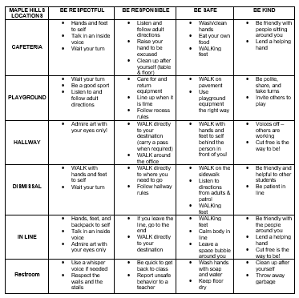
Soaring Eagle Expectations
Throughout our entire building are:
Be Respectful
Be Responsible
Be Safe
Be Kind

Slide 9
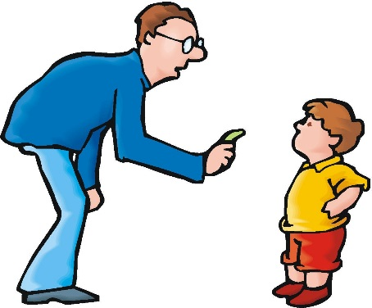
Behavior Management
Each teacher has their own methods and classroom management system.
Let teachers handle discipline problems as students may require different approaches.
Positively reinforce students who are on task.
Never get into a power struggle; ask the teacher or another staff member for help if a student is refusing to do something.
Do not talk about other students or their behavior with other parents.
If a problem occurs outside of the classroom, find the nearest teacher or staff member to report the concern to.

Slide 10
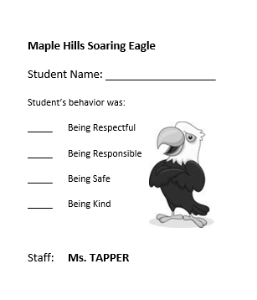
Soaring Eagles
At Maple Hills, students earn a Soaring Eagle for showing Soaring Eagle behavior. Behavior that is…
Respectful
Responsible
Safe
Kind
You can help students with their behavior with positive statements, like, “Remember, be safe with walking feet,” or “I like the way you are being respectful to the art on the walls,” etc.

Slide 11
Thank you for all you do for our students, teachers, and community!

